Slide 1

DataSpark: Illuminating Insights for Global Electronics
Retail Analytics in the Electronics Industry

Slide 2
"Effective sales analysis allows a company to allocate resources more efficiently. It helps determine which products or services are performing well and which are underperforming. This insight enables businesses to focus on promoting high-performing items and reevaluating or discontinuing underperformers."

Slide 3
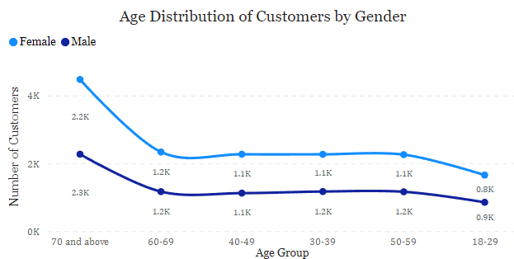
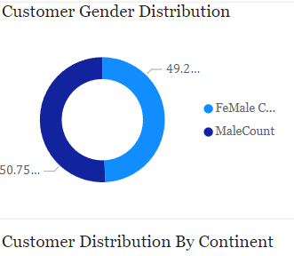
Male And Female Distribution
Small difference in Male and Female counts might indicate that your Products or Services appeal equally to both Genders.
The age group of 70 and above has a higher count compared to other age groups, suggesting that older adults are a significant portion of the customer base.
US nearly have 6k-above customers, on other sides Italy, France, Netherlands having fewer than 1000 customers which implies that places need for increased focus

Slide 4
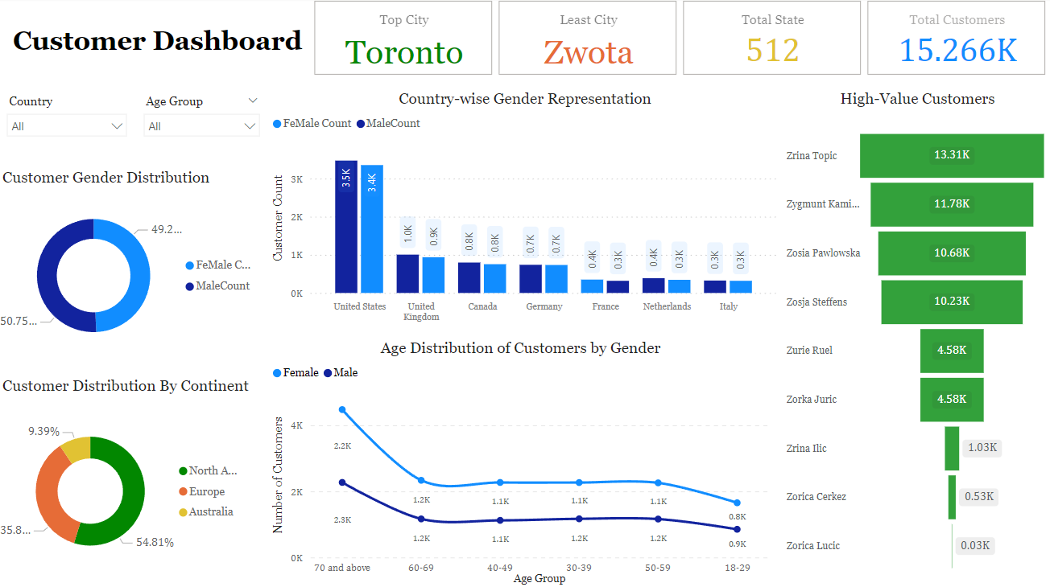

Slide 5
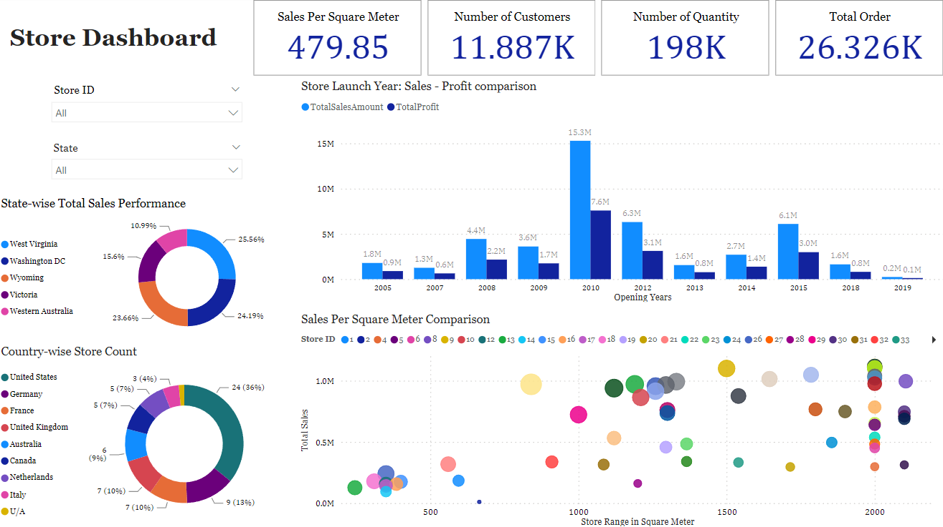

Slide 6
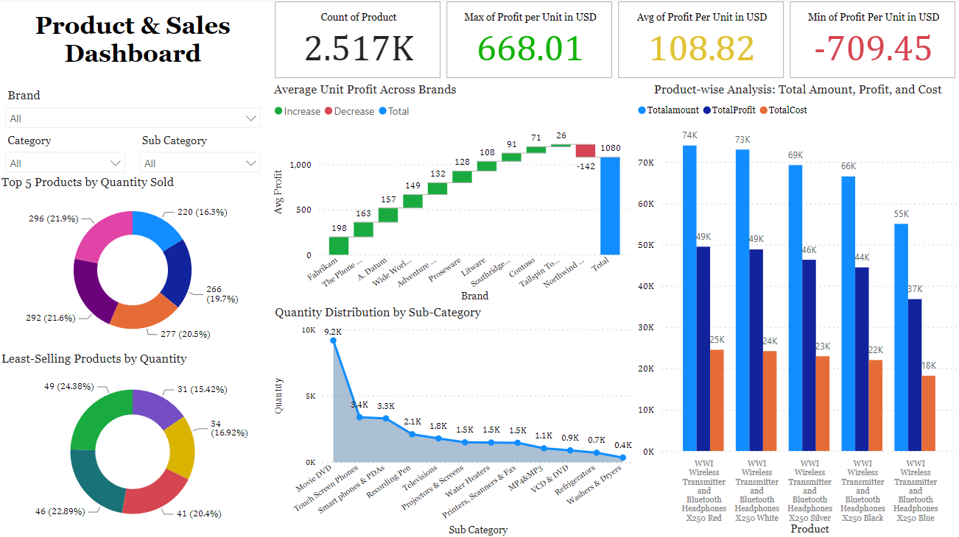

Slide 7
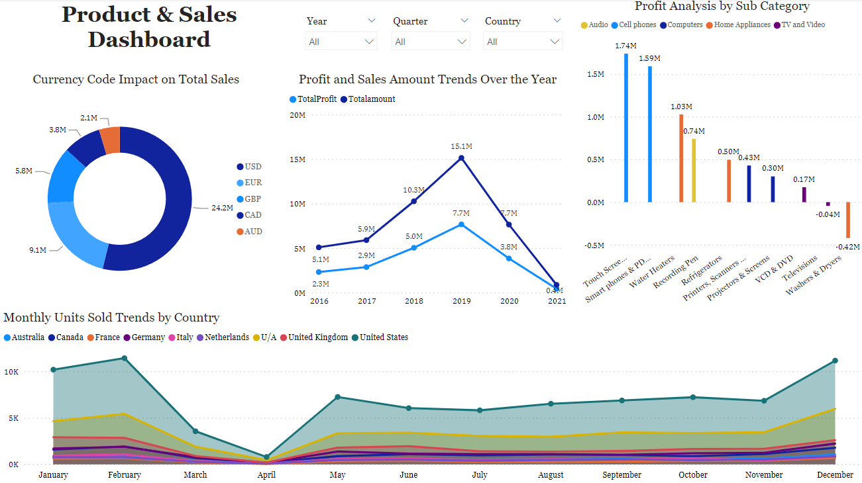

Slide 8
Year Wise Profit Comparision
Year | Total Sales | Previous Year Sales | Profit Percentage
2016 | 5092413 | Null | Null
2017 | 5905153 | 5092413 | 15.95%
2018 | 10264543 | 5905153 | 73.99%
2019 | 15142602 | 10264543 | 47.52%
2020 | 7650993 | 15142602 | - 49.47%
2021 | 879424 | 7650993 | - 88.50%
Growth and Decline: The Data Indicates a Period of Growth in Sales from 2016 to 2019, Peaking in 2019. After that, there is a Significant decline in 2020 and 2021 Profit Percentage Fluctuations: The Profit Percentages Show Large Fluctuations. After a Modest Increase of 15.95% in 2017, there's a sharp rise of 73.99% in 2018 followed by a gain of 47.52% in 2019. Subsequently, there are significant declines of 49.47% in 2020 and 88.50% in 2021.

Slide 9
Enhance Product and Service Offerings: Product Innovation: Continuously innovate and improve your products or services based on market trends and customer feedback. Diversification: Expand your product line to cater to a wider range of customer needs or enter new markets. Quality Assurance: Ensure high-quality standards for your products or services to build trust and *encourage repeat purchases. Optimize Pricing Strategies: Competitive Pricing: Analyze competitor pricing and adjust your pricing strategy to remain competitive without compromising profitability Dynamic Pricing: Implement dynamic pricing models that adjust prices based on demand, customer segments, or market conditions. Bundling and Discounts: Offer product bundles or discounts to incentivize purchases and increase average order value

